Slide 1

Data Mining Project
Sai kiran batchu
Subash Chandra Biswal
Kushal Reddy Chavva
Venkata naga Sukumar vinnakota
Naresh Goud aakula

Slide 2
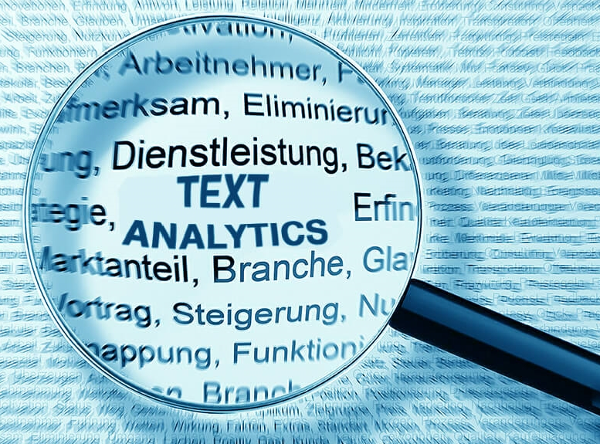

Target Industry
E-commerce
Search Engines
Q&A websites

Slide 3
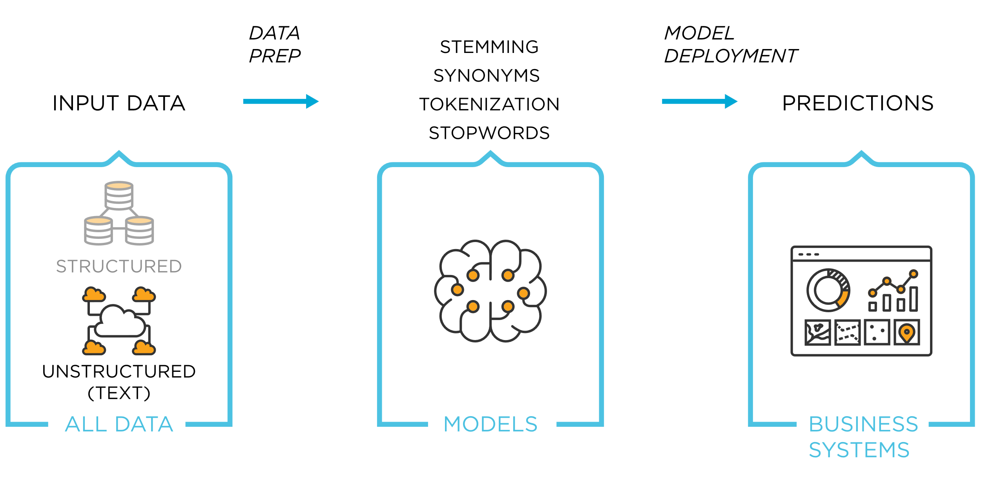
Text Analytics
Text analytics is the automated process of extracting meaning from unstructured text data, to uncover insights, trends, and patterns.
Analysis
Question pair similarity analysis using the Quora Dataset.

Slide 4
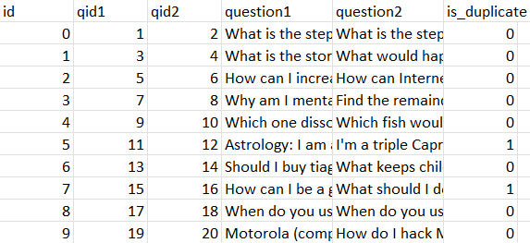
Data
404,290 rows and 6 columns
Id: unique id for each data row
qid1, qid2: unique ids for each question
question1, question2: question strings
is_duplicate: class variable that shows if q1 & q2 are similar

Slide 5
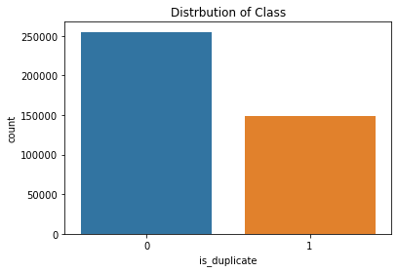
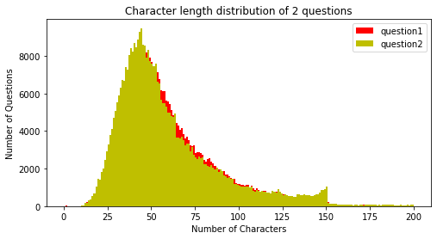
Data Characteristics
Variables:
Independent- question1 and question 2
Dependent- is_duplicate
Train-Test Split:
95% used to train the model and 5% to evaluate the model.

Slide 6
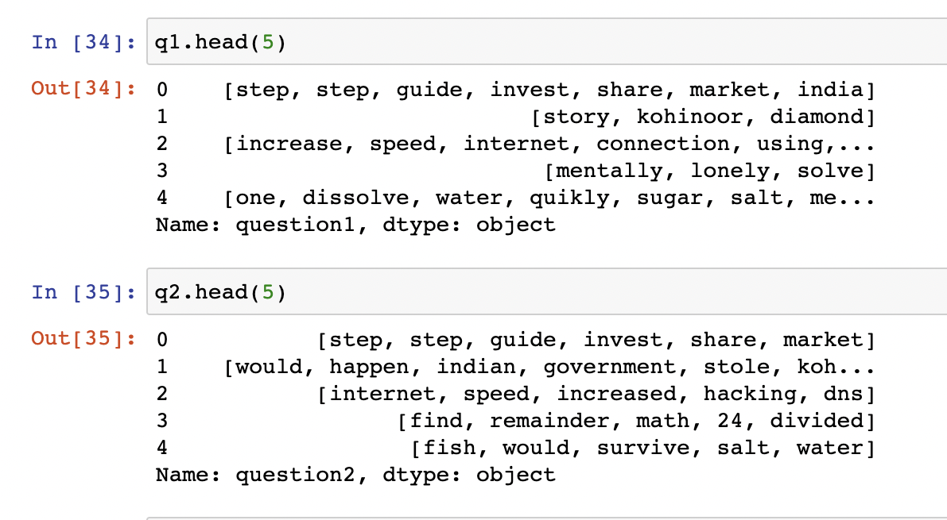
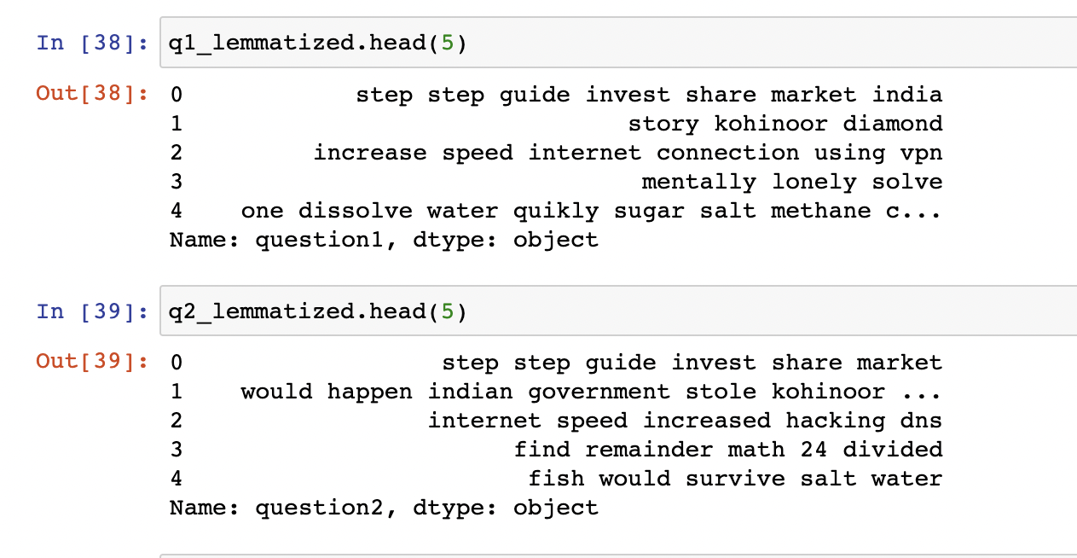
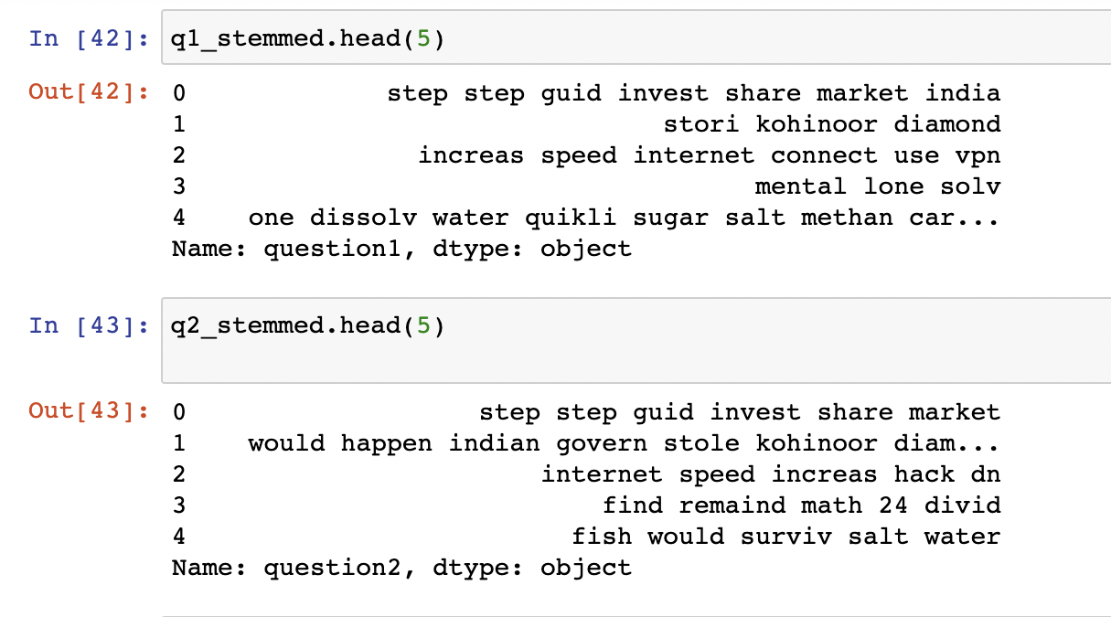
Data Cleaning
The data is cleaned using the techniques:
Stop words
Tokenization
Lemmatization
Stemming

Slide 7
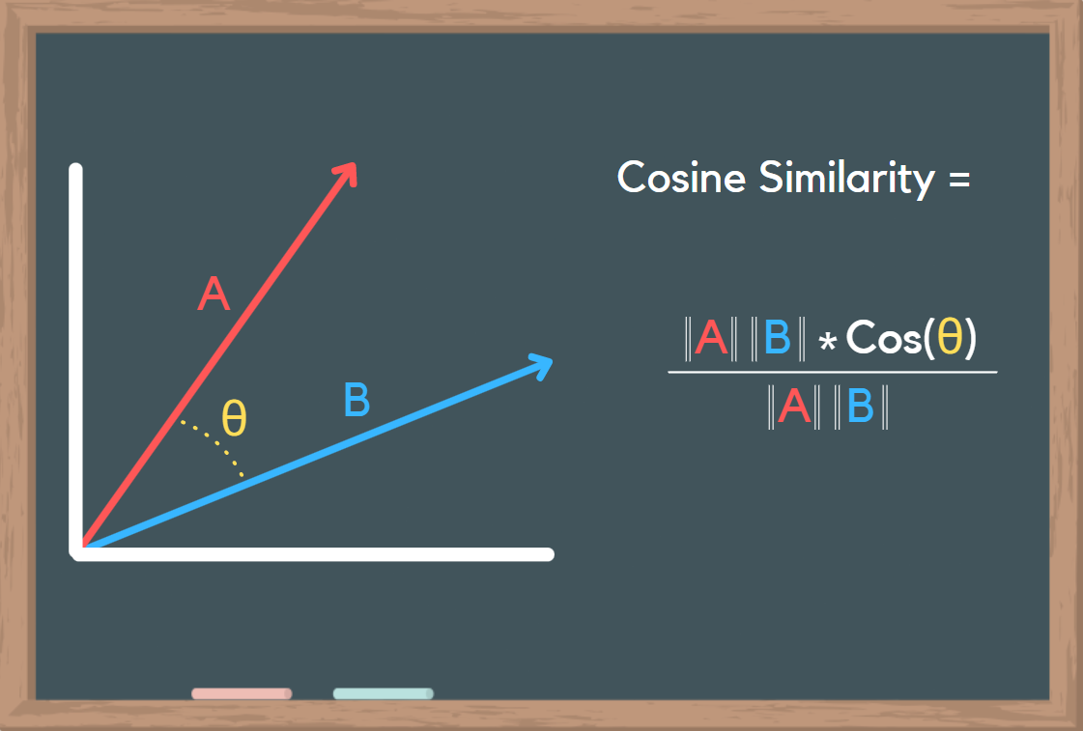
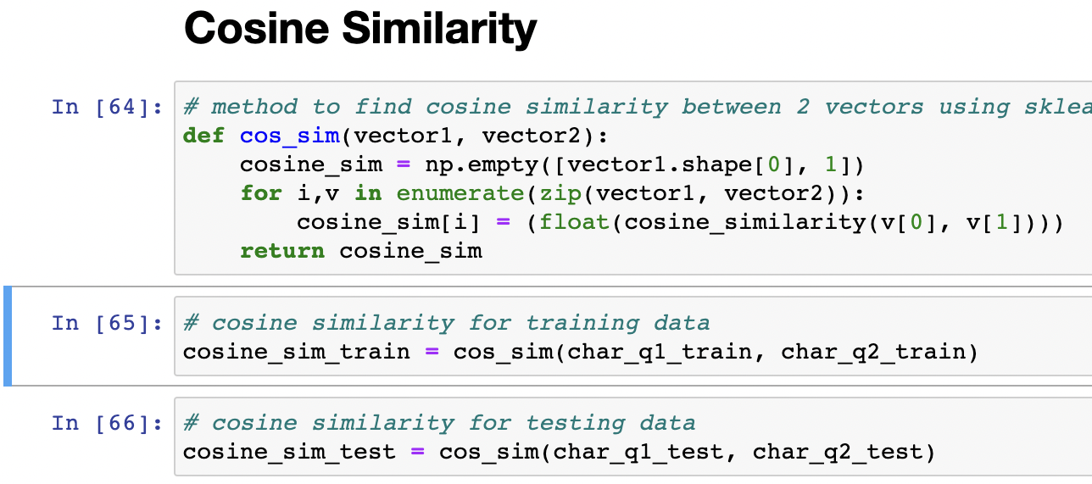
Feature Extraction
Following features are used for modelling:
Cosine Similarity of cleaned and count vectorized independent variables
Used n-grams of 2 to 6 characters for count vectorization.
Difference in character length.

Slide 8
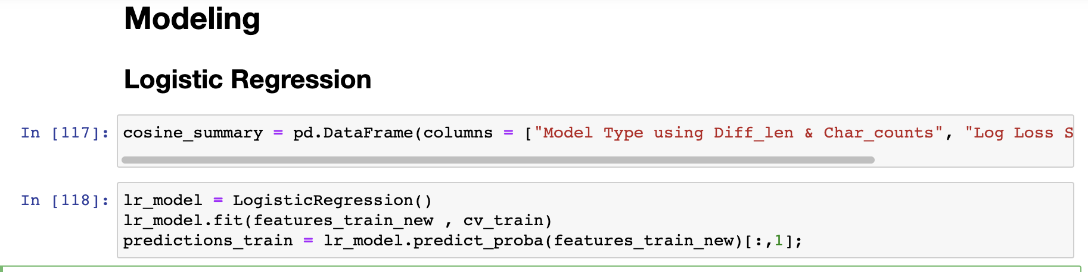
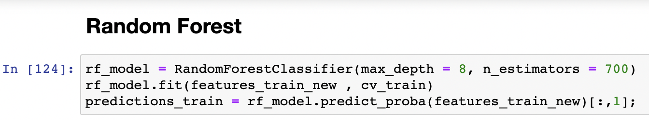
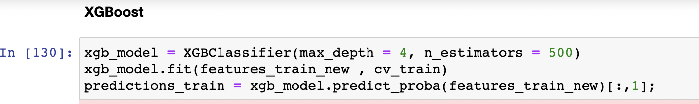
Data Mining Models
Logistic Regression
Random Forest
max_depth = 8
n_estimators = 700
XGBoost
max_depth = 4
n_estimators = 500
Used GridSearchCV of sklearn to
tune the hyper parameters

Slide 9
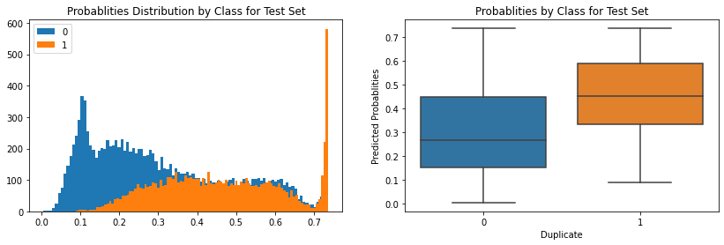
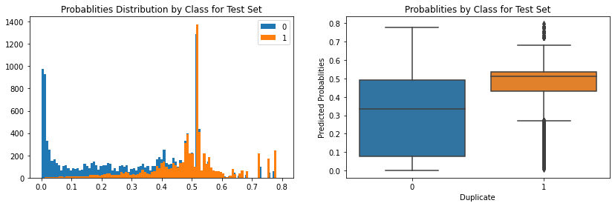
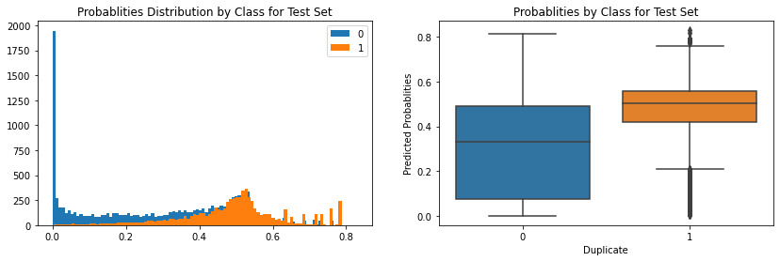
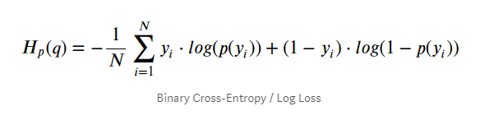
Results
Model Type | Log Loss | Accuracy
Logistic Regression | 0.5715 | 0.6571
Random Forest | 0.5422 | 0.6792
XGBoost | 0.5404 | 0.6791

Slide 10

Thank you!

